Slide 1
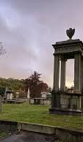
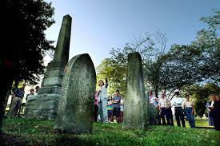
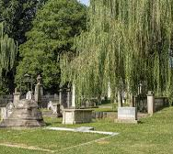
Nashville city cemetery
Who we ARE
Our History
The City Cemetery is the oldest continuously operated public cemetery in Nashville. On March 9, 1820, the Mayor of Nashville and the Aldermen purchased from Richard Cross four acres of land located “on the plains, south of town, for its burying ground.” The cemetery opened on January 1, 1822. Fourteen years later the cemetery had outgrown its original site and more acres were acquired. By 1850 the cemetery was the final resting place for over 11,000 people of every race, religion and economic status. Since the opening, there have been 20,000 interments in the City Cemetery. Over the years, there have been removals including the Civil War Federal soldiers to the National Cemetery, Gallatin Pike, C.S.A. soldiers to the Confederate Circle at Mt. Olivet, and the relocation of graves to new family lots in Mt. Olivet Cemetery after the Civil War.
Type a caption for your photo
Historic grounds full of Nashville’s deep roots
Competitive pricing and regular promotions to help you save money
On the National Registry of Historic Places
A commitment to sustainability and environmental responsibility
CONTACT US
Phone:(661) 661-6161
Web: https://thenashvillecitycemetery.org/
Why choose Nashville city cemetery
Nashville City Cemetery
DISCOVER THE BEST IN Nashville
1001 4th Ave S, Nashville, TN 37210

Slide 2
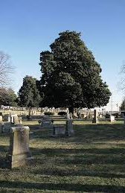
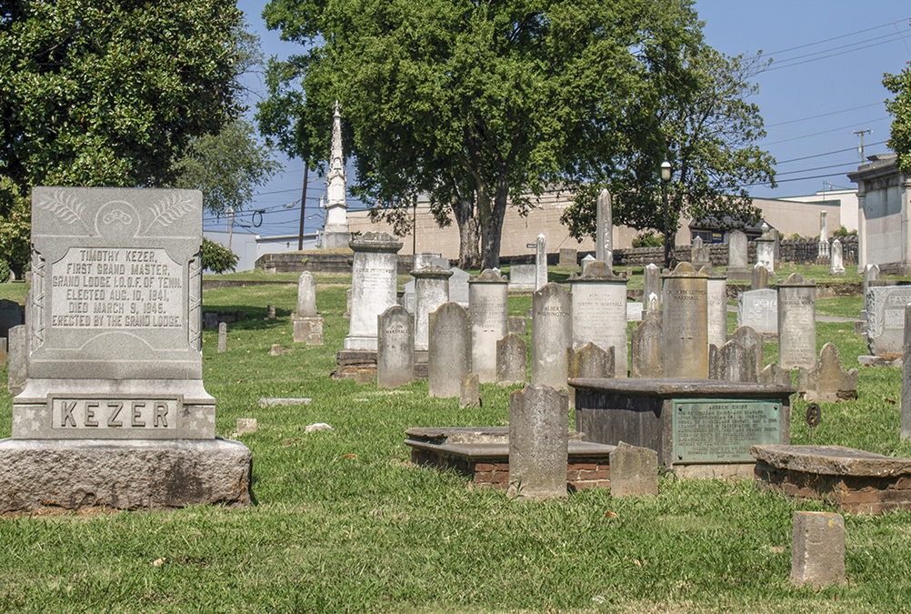
SO WHY CHOOSE Nashville city cemetery?
BEING PREPARED
IS SIMPLE
Ensuring the cemetery remains a well-maintained and welcoming space for families, visitors, and future generations
We are committed to upholding these values in all our efforts, ensuring that the Nashville City Cemetery continues to be a place of historical importance and a source of pride for the community
DISCOVER
THE BEST
WHAT’S OUR MISSION STATEMENT?
Discover the rich history and heritage of Nashville City Cemetery through our guided tours. Our knowledgeable guides will lead you through the grounds, sharing captivating stories of the individuals who shaped our community and the historical events that took place here. You'll explore beautifully preserved monuments, gravestones, and landmarks that provide a glimpse into the past. Whether you are a history enthusiast or simply looking to learn more about Nashville's legacy, our tours offer a unique and educational experience for visitors of all ages. Join us for an enlightening journey through time at the Nashville City Cemetery.
HERE ARE JUST A FEW REASONS:
Deep roots and proximate location to the city center
Provide a tranquil and respectful environment for reflection and remembrance
Expert advice and recommendations tailored to your specific needs
Fostering a sense of community through the preservation and promotion of our rich historical legacy.

